Slide 1
Superposition, Diffraction and Interference

Slide 2
In this Smart Lesson you will learn to:
Define the terms diffraction and superposition.
Apply the principle of superposition to determine the resultant amplitude of two simple waves.
Explain constructive interference and destructive interference of two simple waves.
Explain the formation of standing waves in terms of superposition with reference to constructive and destructive interference, and nodes and antinodes.

Slide 3
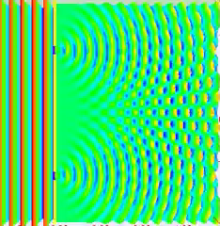
So far, you have been learning about a single wave and its properties.
But have you thought about what happens if there is more than one wave?
What happens if there are 2 sources of waves, such as 2 speakers?
How will the 2 waves interact with each other?

Slide 4


Slide 5
Superposition refers to the process that happens when two waves meet.
The waves pass through each other.
As they do so, their amplitudes are combined.
If the waves match, such as both having crests, or both having troughs, the amplitudes add together. This is known as constructive interference. The waves are said to be in phase.
If the waves do not match, and have a crest and a trough, the amplitudes are added, but one is negative, so in effect they are subtracted. The overall amplitude decreases. This is known as destructive interference.

Slide 6
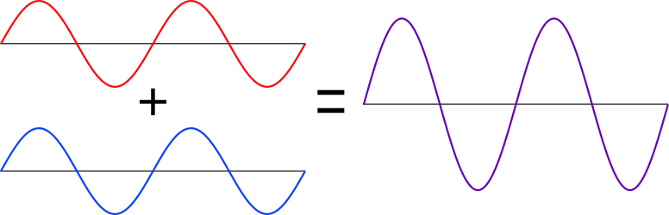
In summary, to calculate the resultant wave when two waves pass each other, simply add the amplitudes.
Superposition is defined as when two or more waves overlap in space, the resultant wave is the algebraic sum of the individual waves.
Crests are considered positive and troughs negative.

Slide 7
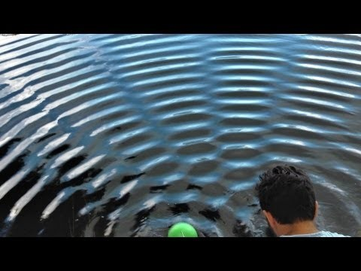

Slide 8
Constructive and destructive interference.
Constructive interference is defined as the interference of two or more waves of the same, or almost the same, frequency and in phase with each other, superposing to produce an observable pattern in intensity.
Simply, it is when the waves interfere to make a larger wave, such as when a crest meets a crest.

Slide 9
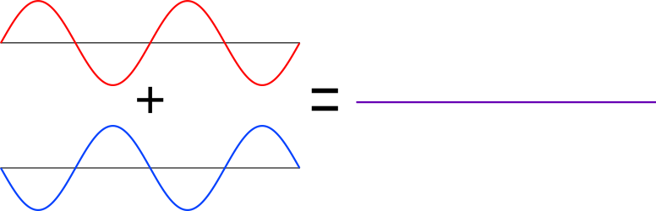
Constructive and Destructive Interference (cont.).
Destructive interference is defined as the interference of two or more waves of the same, or almost the same frequency and 180∘ out of phase with each other, superposing to produce a resultant wave with reduced amplitude.
In this case, the waves interfere to make a smaller wave (or no wave), with a crest meeting a trough.

Slide 10
When two waves are travelling at the same frequency, through the same medium, in opposite directions, a wave pattern can form known as a standing wave.
For example, if a rope is fixed at one end and a wave is sent along the rope from the other end, when it reaches the fixed end it will reflect and bounce back. The reflected wave causes interference with the first moving wave and sets up a standing wave.

Slide 11
Nodes and Antinodes.
In a standing wave, there are points that do not move. This is where there is perfect destructive interference. These points are known as nodes.
Here the nodes are shown as red dots.
A node is defined as point in a medium that is not displaced as a wave is propagated through it.

Slide 12
An antinode is defined as the midway point between each pair of nodes where there is maximum amplitude of vibration.
When you look at a standing wave, this is seen as the point that moves furthest up and down.
Can you identify the antinodes on this wave?

Slide 13
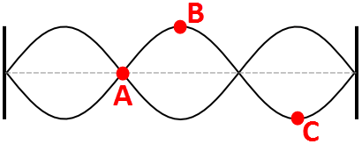
A standing wave is often drawn showing the range of displacement of the waves.
On this image, A labels a node, whilst B and C label antinodes.

Slide 14
Standing waves are defined as waves with stationary vibration patterns formed due to the superposition of waves with particular frequencies.

Slide 15
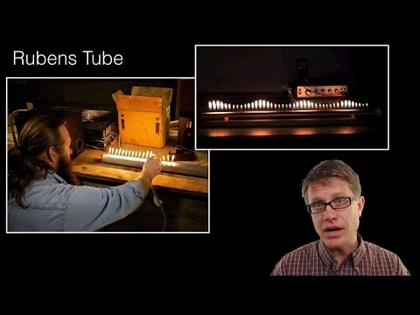

Slide 16
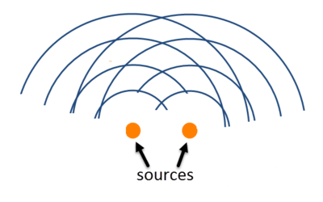
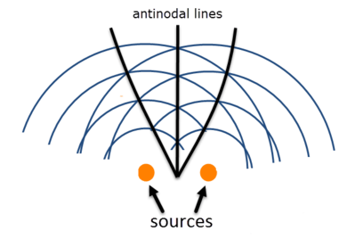
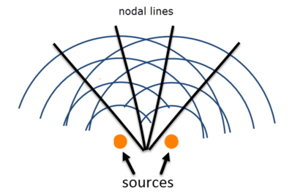
Consider how you would identify nodes and antinodes if there were 2 sources:
The antinodes would occur where the waves overlapped crest with crest and trough with trough, whilst the nodes occur where the waves cancel each other out - crest with tough:

Slide 17
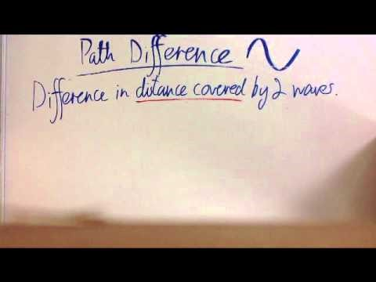

Slide 18
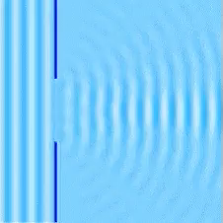
When waves encounter an object or pass through a gap, a process called diffraction occurs.
Diffraction is defined as a phenomenon in which waves either bend behind a barrier or the wavefront is broken up into many small sources.

Slide 19


Slide 20
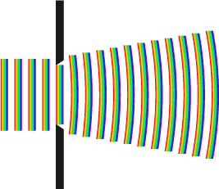
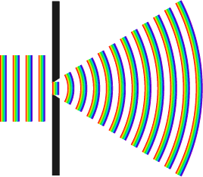
As the gap size is decreased, the diffraction increases.
Maximum diffraction occurs when the gap size equals the wavelength.

